Slide 1
Employee Data Analysis using Excel
STUDENT NAME: SRILEKHA S
REGISTER NO: 312216811.
DEPARTMENT: B.COM (ACCOUNTING AND FINANCE).
COLLEGE: SHRI KRISHNASWAMI COLLEGE FOR WOMEN.

Slide 2
PROJECT TITLE
Employee Performance Analysis using Excel

Slide 3


AGENDA
Problem Statement
Project Overview
End Users
Our Solution and Proposition
Dataset Description
Modelling Approach
Results and Discussion
Conclusion
3/21/2024 Annual Review

Slide 4

PROBLEM STATEMENT
Analyze employee performance using Excel to identify top performers, underperformers, and trends. This analysis will involve organizing performance data, calculating metrics, and using visual tools like charts and pivot tables to draw insights. The goal is to provide actionable recommendations for improving productivity and making informed decisions on promotions, training, and resource allocation.

Slide 5

PROJECT OVERVIEW
The Employee Performance Analysis project aims to use Excel to evaluate and monitor employee performance across various metrics such as productivity, attendance, and peer reviews. The project involves organizing performance data, calculating key metrics, and visualizing trends through charts and pivot tables. The insights gained will help management make data-driven decisions on promotions, training needs, and resource allocation, ultimately enhancing overall organizational performance.
.

Slide 6

WHO ARE THE END USERS?
The end users of the employee performance analysis using Excel are HR managers, team leaders, department heads, and executive management. They use the analysis to make informed decisions on employee development, promotions, training, and resource allocation.

Slide 7

OUR SOLUTION AND ITS VALUE PROPOSITION
Condition formatting missing.
Filter remove.
Formula Performance.
Pivot summary.
Graph data visualization.

Slide 8
Dataset Description
Employee data set.
There is 26 feature I have taken only 9 features.
Employee ID in numerical value.
Name-start name ,End name.
Employee type .
Performance level.
Gender-Male, Female.
Employee Rating in numerical value.

Slide 9

THE "WOW" IN OUR SOLUTION
Performance – IFS(Z8>5,”VERY HIGH”,Z8>4,”HIGH”
Z8>3,”MED”,TRUE,”LOW”).
3/21/2024 Annual Review
9

Slide 10
MODELLING
Data collection:
Data collected by employee performance analysis.
Using Excel we have selected features
Features collection:
Employee ID .
Gender.
Performance level.
Employee rating.
Pivot table:
I create pivot table .
And diagrams.
I shown the performance level
In diagram.
10

Slide 11
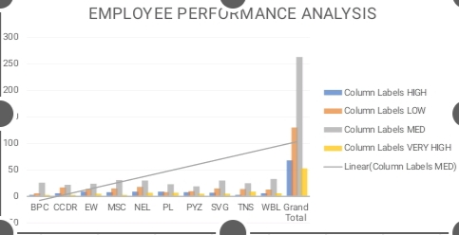
RESULTS
11

Slide 12
conclusion
The employee performance analysis using Excel provided a clear and organized assessment of individual contributions, highlighting key metrics such as productivity, quality of work, and overall efficiency. The analysis identified top performers, areas for improvement, and trends over time, enabling data-driven decisions for future training, promotions, and resource allocation. Overall, the Excel-based analysis served as a valuable tool for enhancing workforce management and driving organizational success.

